Slide 1
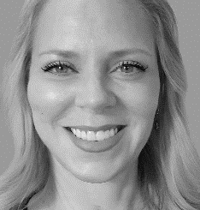
COPYRIGHT, COPYLEFT & FAIR USE for Students & Media-makers
Juliet Davis, MFA, MAT Associate Professor of Communication The University of Tampa POWERPOINT & VIDEOS located at www.julietdavis.com
Notes:
VIDEO SCRIPT: V.O. Hi, Everyone, I’m Juliet Davis, and this presentation on “Copyright, Copyleft & Fair Use” can viewed as videos or downloaded as a PowerPoint at JulietDavis.com. There are 6 videos in the series. This is an overview.

Slide 2
© 2002-2020 Juliet Davis
All media inserted in this presentation was used under one or more of the following conditions:
Licensing/Permission, e.g., free online sources; paid sources
“Fair Use” (Intended), i.e., limited use for criticism, comment, news reporting, teaching, scholarship, and/or research).
Public Domain (expired copyright or government source)
Original Authorship (I created it)
This presentation was made possible by a Learninig Enrichment Grant from The University of Tampa.
.
Notes:
It was made possible by a Learning Enrichment Grant from The University of Tampa, all media here was used under these conditions listed on the right, which we will explore.

Slide 3
CITATIONS OF SOURCES: All media sources are cited in the PowerPoint version of this presentation (citations appear in the notes under the slides), and in the video bibliography at the end of this series. Note that citing a media source does not automatically give a person permission to use the media. This presentation explains how to use outside media sources while avoiding copyright infringement.
OPTION: Instructors, turn off your computer’s audio to avoid automatic playback of sound in PowerPoints.
Notes:
Citations are located on the notes on each PowerPoint slide and at the end of each video in a bibliography.

Slide 4
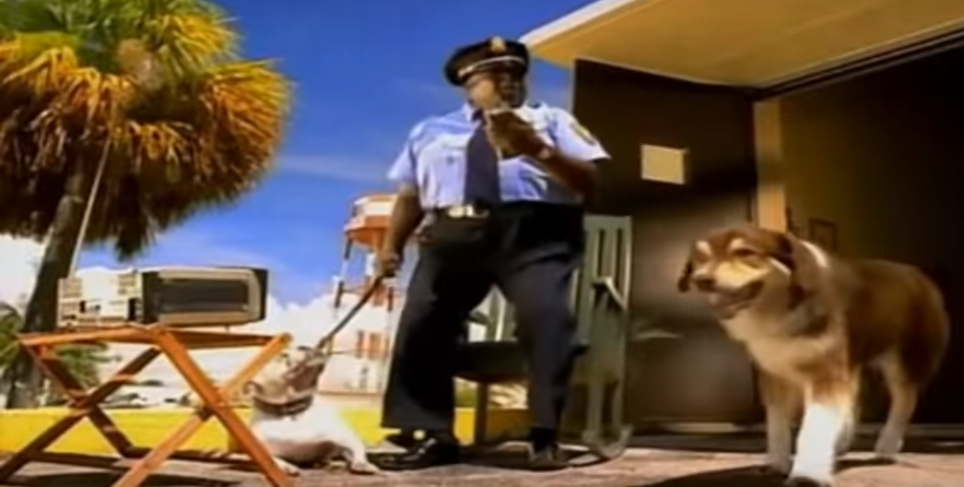
How many of you have snagged your favorite song and used it as a sound track for a video you made?
OOPS!
Notes:
V.O. How many of you have snagged your favorite song and used it as a sound track for a video you made? _________________________ MEDIA SOURCE: SFX: “Dog Snarling” (dogsbarking.mp3) https://www.youtube.com/audiolibrary/soundeffects?ar=1583940074092&nv=1“dogbarking.mp3” YouTube Audio Library (free download)
Screen shot: Baha Men. “Who Let the Dogs Out.” Posted to YouTube by Atriem Records: https://www.youtube.com/watch?v=Qkuu0Lwb5EM. Accessed: 20 Jun 2018

Slide 5
PRESENTATION 1
THEN what happened? You probably had to change the music if you wanted to post it online.
Notes:
[Music up and under] V.O. . . . Yikes, not good. What happened next? You probably had to change the music if you wanted to post it online. _____________ MEDIA SOURCE: Baha Men. “Who Let the Dogs Out.” Records, 2000. Posted to YouTube by Atriem Records: https://www.youtube.com/watch?v=Qkuu0Lwb5EM. Accessed: 20 Jun 2018 Featured under the auspices of fair use for educational purposes, in limited amount, to demonstrate a common student practice.

Slide 6
. . . and lose all those cool edits you synched with the music? (Bummer.)
Notes:
V.O. . . and lose all those cool edits you synched with the music? (Bummer?) _____________________ MEDIA SOURCES: SFX: Flashkit.com (free download) “urrg” Demo Sound Effect by Tom Soron, posted 6/20/2002 http://www.flashkit.com/soundfx/People/Grunts/urrg-Tom_Soro-7776/index.php Accessed 6/20/2018 Image Source: AnimatedImagery.org Permissions: free use, attribution requested http://www.animatedimages.org/cat-dogs-202.htm Accessed 6/20/2018

Slide 7
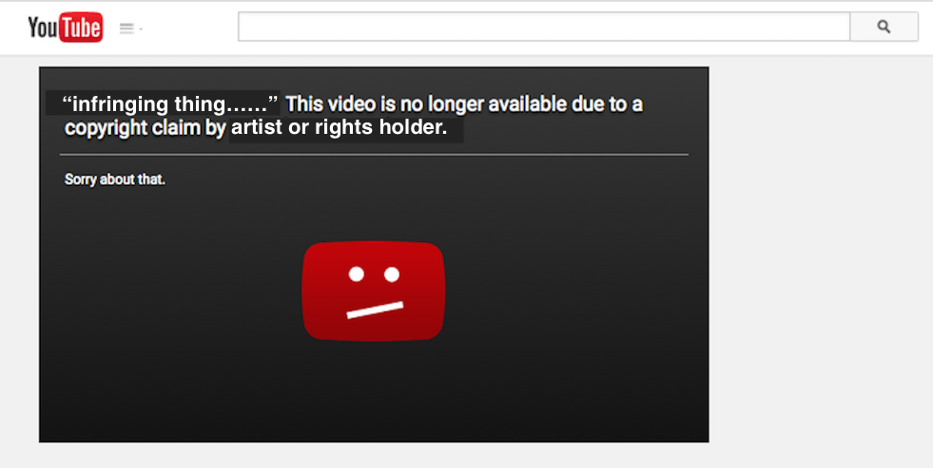
(You might have seen this notice.)
Notes:
Image Source: YouTube Screen Shot

Slide 8
Are you “ganking?”
(yanking images from Google to insert into your work, whether you have permission to use them or not)
Notes:
V.O. And . . . are you “ganking?” You know: [click] yanking images from Google to insert into your work, whether you have permission to use them or not? __________________ NOTES: “Ganking” is a term originated by Jason Beaird, “How Not to Impress,” The Principles of Beautiful Web Design, 2nd Edition https://www.sitepoint.com/premium/books/the-principles-of-beautiful-web-design-2nd-edition/preview/how-not-to-impress-12fbd24 Accessed 5/20/2019 Giphy’s “User Terms of Service” states: “Generally speaking, you're only allowed to use content that you find on the site in connection with your use of the Services and solely for personal and non-commercial purposes” https://support.giphy.com/hc/en-us/articles/360020027752-GIPHY-User-Terms-of-Service. Accessed 5/20/2019 __________________ MEDIA SOURCES: Google Search Results for “Bulldog”: Screen Shot 6/20/2018 Featured under the auspices of fair use for educational purposes to demonstrate the practice of randomly acquiring images from searches. “Psycho Violin Screech Sound” by werewolf SoundBoard.com: https://www.soundboard.com/sb/sound/905442 Free download. “Look Flashing Sticker” by Corey Paige Designs: Giphy: https://giphy.com/stickers/coreypaige-photo-flashing-arrows-35EoEGijPiFk6D6w0I Source: https://coreypaigedesigns.com/ “Arrow Want Sticker” by Sweaty Betty Giphy: https://giphy.com/stickers/sweatybetty-point-arrows-wantwantwant-h4wcTPQspvF2hi92FB Source: http://www.sweatybetty.com “Arrow Swipe Sticker” by ET Canada Giphy.com: https://giphy.com/stickers/EntertainmentTonightCanada-point-arrows-etcanada-dCc7JLBM24BxDvA3rr Source: http://www.etcanada.com “Look Arrow Sticker” by Unique Vintage Giphy.com: https://giphy.com/stickers/uniquevintage-arrow-arrows-uvgifs-lYiNFQZeAC4mAWsiBR Source: https://www.unique-vintage.com/

Slide 9
Are you regramming?
(Reposting other people’s content to social media without permission or credit)
In professional social media, this can cause some problems.
Notes:
Are you “regramming?” Reposting other people’s content to social media without permission or credit? ______________________ NOTES: This cat posted by IMAGUR user nightripper was reposted thousands of times without permission. In at least one case, a different person claimed to be the author. IMGUR “Terms of Service”: https://imgur.com/tos “By downloading an image or copying other user-generated content (UGC) from Imgur, you agree that you do not claim any rights to it. The following conditions apply:
You may use UGC for personal, non-commercial purposes.
You may use UGC for anything that qualifies as fair use under copyright law, for example journalism (news, comment, criticism, etc.), but please include an attribute ("Imgur" or "courtesy of Imgur") next to where it is displayed.
You may not use UGC for non-journalistic commercial purposes.
Your use of UGC is at your own risk. IMGUR MAKES NO WARRANTIES OF NON-INFRINGEMENT, and you will indemnify and hold Imgur harmless from any copyright infringement claims arising out of your use of the UGC. (See our general disclaimers below.)”
_______________________
SFX: Flashkit.com (free download) http://www.flashkit.com/soundfx/ http://www.flashkit.com/soundfx/People/Laughing/Mad_Laug-Lopar-XL-8656/index.php »Author:Lopar-XL | Search by Lopar-XL»Website:http://www.nationnarrownet.com Accessed: 6/20/2018 Image Source: IMAGUR https://imgur.com/gallery/23bHrnO “Cat on Computer” by nightripper, posted 12/10/2016 https://imgur.com/user/nightripper Accessed 12/10/2019

Slide 10
Copyright Infringement
(Use that encroaches on the rights of the owner of that work . . .)
Notes:
If so, you could be guilty of “copyright infringement:” in other words, [click] use that encroaches on the rights of the owner of that work . . . ____________________ MEDIA SOURCES:
Cat Image Source: Wikimedia Commons, the free media repository https://commons.wikimedia.org/wiki/File:Kittyscaredlolcat.jpg Accessed 23 May 2019. License: Creative Commons Attribution 2.0, https://creativecommons.org/licenses/by/2.0/deed.en Credit: shira gal SFX: Flashkit.com free download www.flashkit.com Accessed 20 Jun2019.

Slide 11
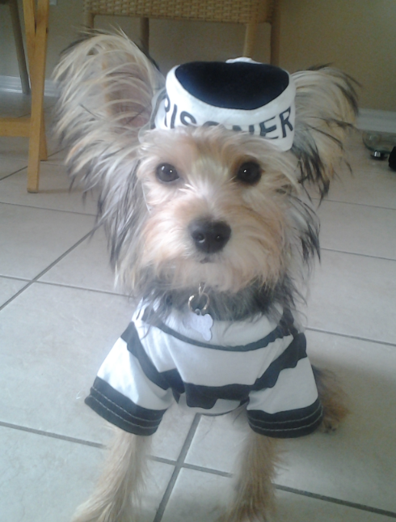
. . . which is illegal.
Notes:
. . . And that’s illegal. [Music up and Under: “Bad Boys” theme]
MEDIA SOURCES: Image Credit: Petful.com (https://www.flickr.com/photos/petsadviser-pix/8126534491) License: Commons License 2.0, which states: “You must give appropriate credit, provide a link to the license, and indicate whether changes were made.” Link to Creative Commons License: https://creativecommons.org/licenses/by/2.0/ No changes were made. “Cops Theme Song (TV Version)” Artist: Inner Circle
Album: Bad To The Bone
Writer: Ian Lewis
Licensed to YouTube by INgrooves (on behalf of DubShot Records/Sound Bwoy Entertainment); UBEM, CMRRA, LatinAutor - SonyATV, LatinAutor, UMPG Publishing, SOLAR Music Rights Management, EMI Music Publishing, BMI - Broadcast Music Inc., and 12 Music Rights Societies https://www.youtube.com/watch?v=BUjUz_QEh48 Accessed 23 May 2019

Slide 12
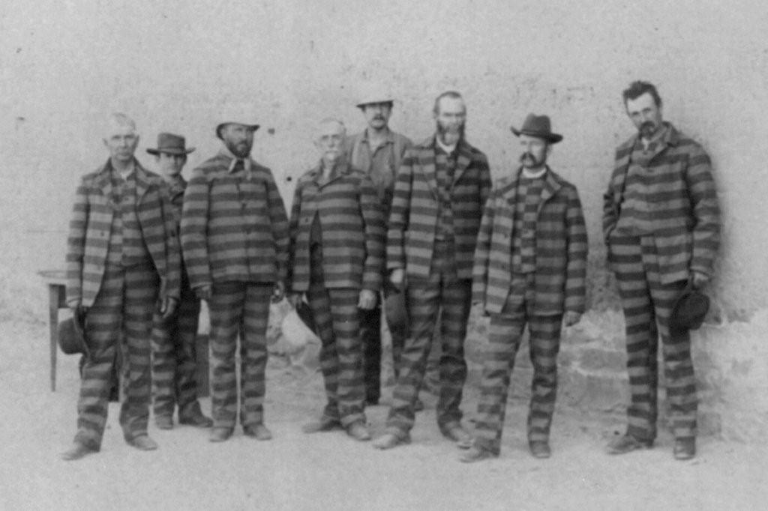
Notes:
MEDIA SOURCES: Image: Utah Prisoners, 1885 Author: John P. Soule U.S. Library of Congress WikimediaCommons.com https://commons.wikimedia.org/wiki/File:LOC_Utah_Prisoners_c1885.jpg Accessed 11 Mar 2020

Slide 13
While you probably won’t go to jail, you could get into some expensive trouble.
“Things That Can Happen When You Get Caught Breaking Copyright Laws.” LegalZoom.com
.
Notes:
[Animated gif with siren blaring] While you probably won’t go to jail, you could get into some expensive trouble. SOURCE: Ingram, David. “Things That Can Happen When You Get Caught Breaking Copyright Laws.” LegalZoom.com,
https://info.legalzoom.com/things-can-happen-caught-breaking-copyright-laws-20296.html. Accessed 23 May 2019. __________________________ MEDIA SOURCES: NOTE: This image and source will be part of a critical thinking exercise at the end of the presentation and is shown here under the auspices of fair use for educational purposes. Image Source: YouTube, https://www.youtube.com/watch?v=xKHYW8PZQ9Y Excerpt from: “Dubai Police Cars – The World’s Fastest Police Cars!” SFX: Flashkit.com free download.

Slide 14
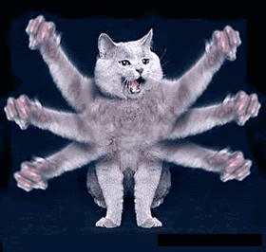
“OH, SO SORRY!”
Notes:
MEDIA SOURCES
Image Source: Excuse Meme “6 Armed Cat” http://www.excusememe.com/imagebase/5261
The page encourages sharing the image. Accessed 5/21/19. [No author identified.] SFX: “Monster/Creature Scream 1” Obtained from www.Zapsplat.com (free download, attribution required) https://www.zapsplat.com/music/monstercreature-scream-1/ License: Commercial or Non-commercial Use, Attribution Required (https://www.zapsplat.com/license-type/standard-license/)

Slide 15
“Right.”
Notes:
V.O. Okay, that might not work. MEDIA SOURCES: SFX: Flashkit.com (free download) “urrg” Demo Sound Effect by Tom Soron, posted 6/20/2002 http://www.flashkit.com/soundfx/People/Grunts/urrg-Tom_Soro-7776/index.php Accessed 6/20/2018 Image Source: AnimatedImagery.org Permissions: free use, attribution requested http://www.animatedimages.org/cat-dogs-202.htm Accessed 6/20/2018

Slide 16
Copyright is “a form of protection provided by the laws of the United States for ‘original works of authorship’ . . . "
According to the U.S. Copyright Office:
Source: “U.S. Copyright Office Definitions,” Copyright.gov. https://www.copyright.gov/help/faq/definitions.html
Notes:
According to the U.S. Copyright Office, copyright is “a form of protection provided by the laws of the United States for ‘original works of authorship.’” _________________________ SOURCE: Source: “U.S. Copyright Office Definitions,” Copyright.gov. https://www.copyright.gov/help/faq/definitions.html

Slide 17
Copyright: A legal right Copywriter: One who writes copy (advertising/publicity text)
Difference between copyright and copywriter:
Notes:
Some people get these terms confused: copyright and copywriter, two very different things. One is a legal right.
The other writes copy.

Slide 18
CONTENTS
Introduction: “Who Let the Dogs Out?”
Copyright and Infringement
How Can I Register My Copyright (or “Copyleft”) and Post Notice?
How Can I Use Others’ Works Legally?
When Can I Claim “Fair Use?”
How can I use my own work legally?
UPDATES For updates visit www.JulietDavis.com.
Notes:
So let’s get going. . [Click] In this actually a series of videos and accompanying PowerPoints that will help you use media legally, in social media, remixing, advertising, journalism, class projects, and more—and why it’s important. It’s useful for anyone publishing and distributing their work in print or electronic media. -[Click] The introduction is called “Who Let the Dogs Out,” and we’ll see why in a second. -[Click]. what can happen if you get caught infringing on copyright . [Click] how to register your own copyright . [Click] how to use others’ works legally, . [Click] and when to claim “fair use.” . [Click] Do you know how to use your own work legally? That might be a little more involved than you think. . . .
_________________________ MEDIA SOURCES: Purchased license at VectorStock.com through account: Juliet Davis https://www.vectorstock.com/royalty-free-vector/black-female-teacher-with-textbook-character-vector-25078466

Slide 19
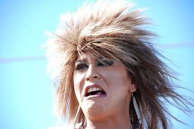
“I hate that pic—take it down!”
Notes:
Right?
IMAGE SOURCE:
Image Source: Max Pixel. “Scream Drunk Angry Crazy.” Free Download: https://www.maxpixel.net/Scream-Drunk-Angry-Crazy-1256467 License: For commercial use, link referral required.

Slide 20
Introduction:
“Who Let the Dogs Out?”
Notes:
Here’s an overview of main ideas.

Slide 21
Time to be a copyright scholar.
A quick overview of how to avoid copyright infringement: FLIP
Fair Use: limited use for criticism, comment, news reporting, teaching, scholarship, research
Licensing/Permissions: use under specified conditions articulated in writing
I created it: Original Authorship
Public Domain: use of work with expired copyright or from a U.S. government source
Notes:
Time to be a copyright scholar. Here are some easy ways to avoid copyright infringement. Just remember the acronym “FLIP.” You might want to pause this video now to write down these notes, just so you remember them.
Fair Use is limited use for criticism, comment, news reporting, teaching, scholarship, and research. In this case, you refer to short excerpts, just like you do when you use a short quote in a paper and cite your source, or you comment on an image in a blog or newscast.
Licensing allows work to be used under specified conditions—for example, crediting the author, paying for use, or using for noncommercial purposes, etc. Or you can just ask for permission by emailing a form from the Internet.
Of course, you can always create your own works of original authorship. That’s the “I” in FLIP: “I created it.” Or you could use works freely that are in Public Domain, which have expired copyrights or come from a U.S. government source.
We’re going to take in-depth looks at each of these areas in future presentations.

Slide 22
First, let’s take a look at the media we just used.
Any problems?
Notes:
But first, let’s take a look at some media we’ve already used in this presentation.

Slide 23
Example: Let’s take a look at this slide:
The bulldog photo
The red arrow
The graduation cap
The music excerpt from this performance of “Pomp and Circumstance” by Blue Claw Philharmonic
Notes:
V.O. Where did we get the bulldog photo? The red arrow? The cap? The music? Can we use these legally? ______________________________________________________
MEDIA SOURCES: Blue Claw Philharmonic. “Pomp and Circumstance” (Orchestra Extended Longest Mix) From the Album Pomp and Circumstance: Graduation March Processional (Remix 4) Release Date: February 17, 2016
Label: Blue Claw Music Purchase Date: 23 May 2019 (Juliet Davis) Amazon.com https://www.amazon.com/Pomp-Circumstance-Orchestra-Extended-Longest/dp/B01BV36KRG/ref=sr_1_3?crid=229IWDVXCKU0R&keywords=pomp+and+circumstance+mp3&qid=1558645602&s=gateway&sprefix=Pomp+and+Circu%2Caps%2C175&sr=8-3 Bulldog Photo: Pixabay.com (free download): https://pixabay.com/photos/bulldog-bull-dog-happy-english-dog-1275748/ License: CC0 Creative Commons Free for commercial use, no attribution required. “Graduation Degree Cap” Image: Source: www.SeekPNG.com: License: (free download) Personal Use https://www.seekpng.com/ipng/u2q8a9u2o0a9a9a9_graduation-degree-cap-png-degree-cap-png/ https://www.seekpng.com/ks/cap/ ________________

Slide 24
First, the red arrows: “I made them” (Original Authorship)
(What??? Amazing!)
Notes:
First, the red arrows. Amazing . . .

Slide 25
Bulldog Photo: Which FLIP condition is this? Is it fair use, licensing/permissions, “I made it,” or public domain?
Answer: Licensing and Permissions. Free download from Pixabay, Creative Commons License CC0: (free for commercial use, no attribution required).https://pixabay.com/photos/bulldog-bull-dog-happy-english-dog-1275748/
Notes:
But I didn’t take this photo. Pause the video for a moment and examine the source of the photo. Which FLIP condition is this? The answer is Licensing and Permission: The photo was a free download from Pixabay, and the “Creative Commons” license allows free commercial use, with no attribution required—which means we don’t even have to credit the author. ________________________________________________________ IMAGE SOURCE: Bulldog Photo: Pixabay.com (free download): https://pixabay.com/photos/bulldog-bull-dog-happy-english-dog-1275748/ License: CC0 Creative Commons Free for commercial use, no attribution required.

Slide 26
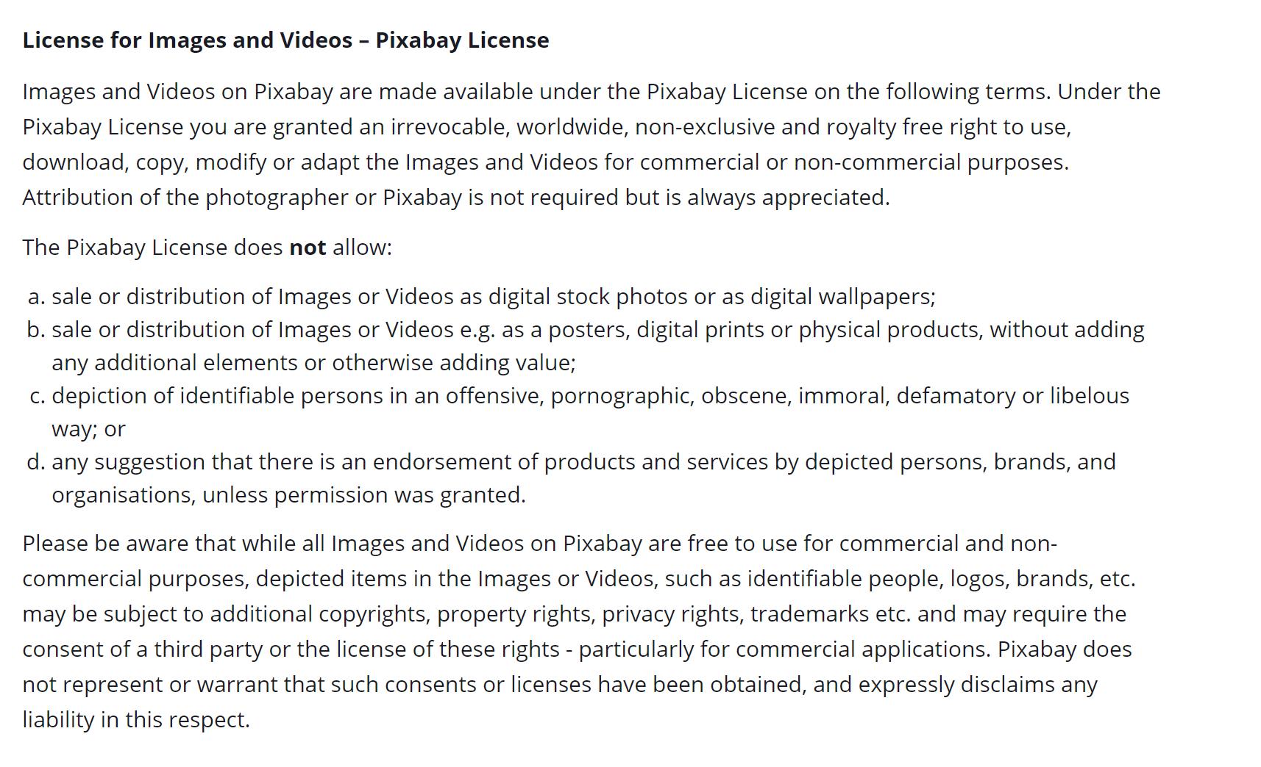
Check a website’s licensing
Notes:
It’s a good idea to check a website’s licensing to make sure it grants permission for use. For example, Pixabay claims it owns the copyright on all images but allows for free use for commercial or noncommercial purposes.

Slide 27
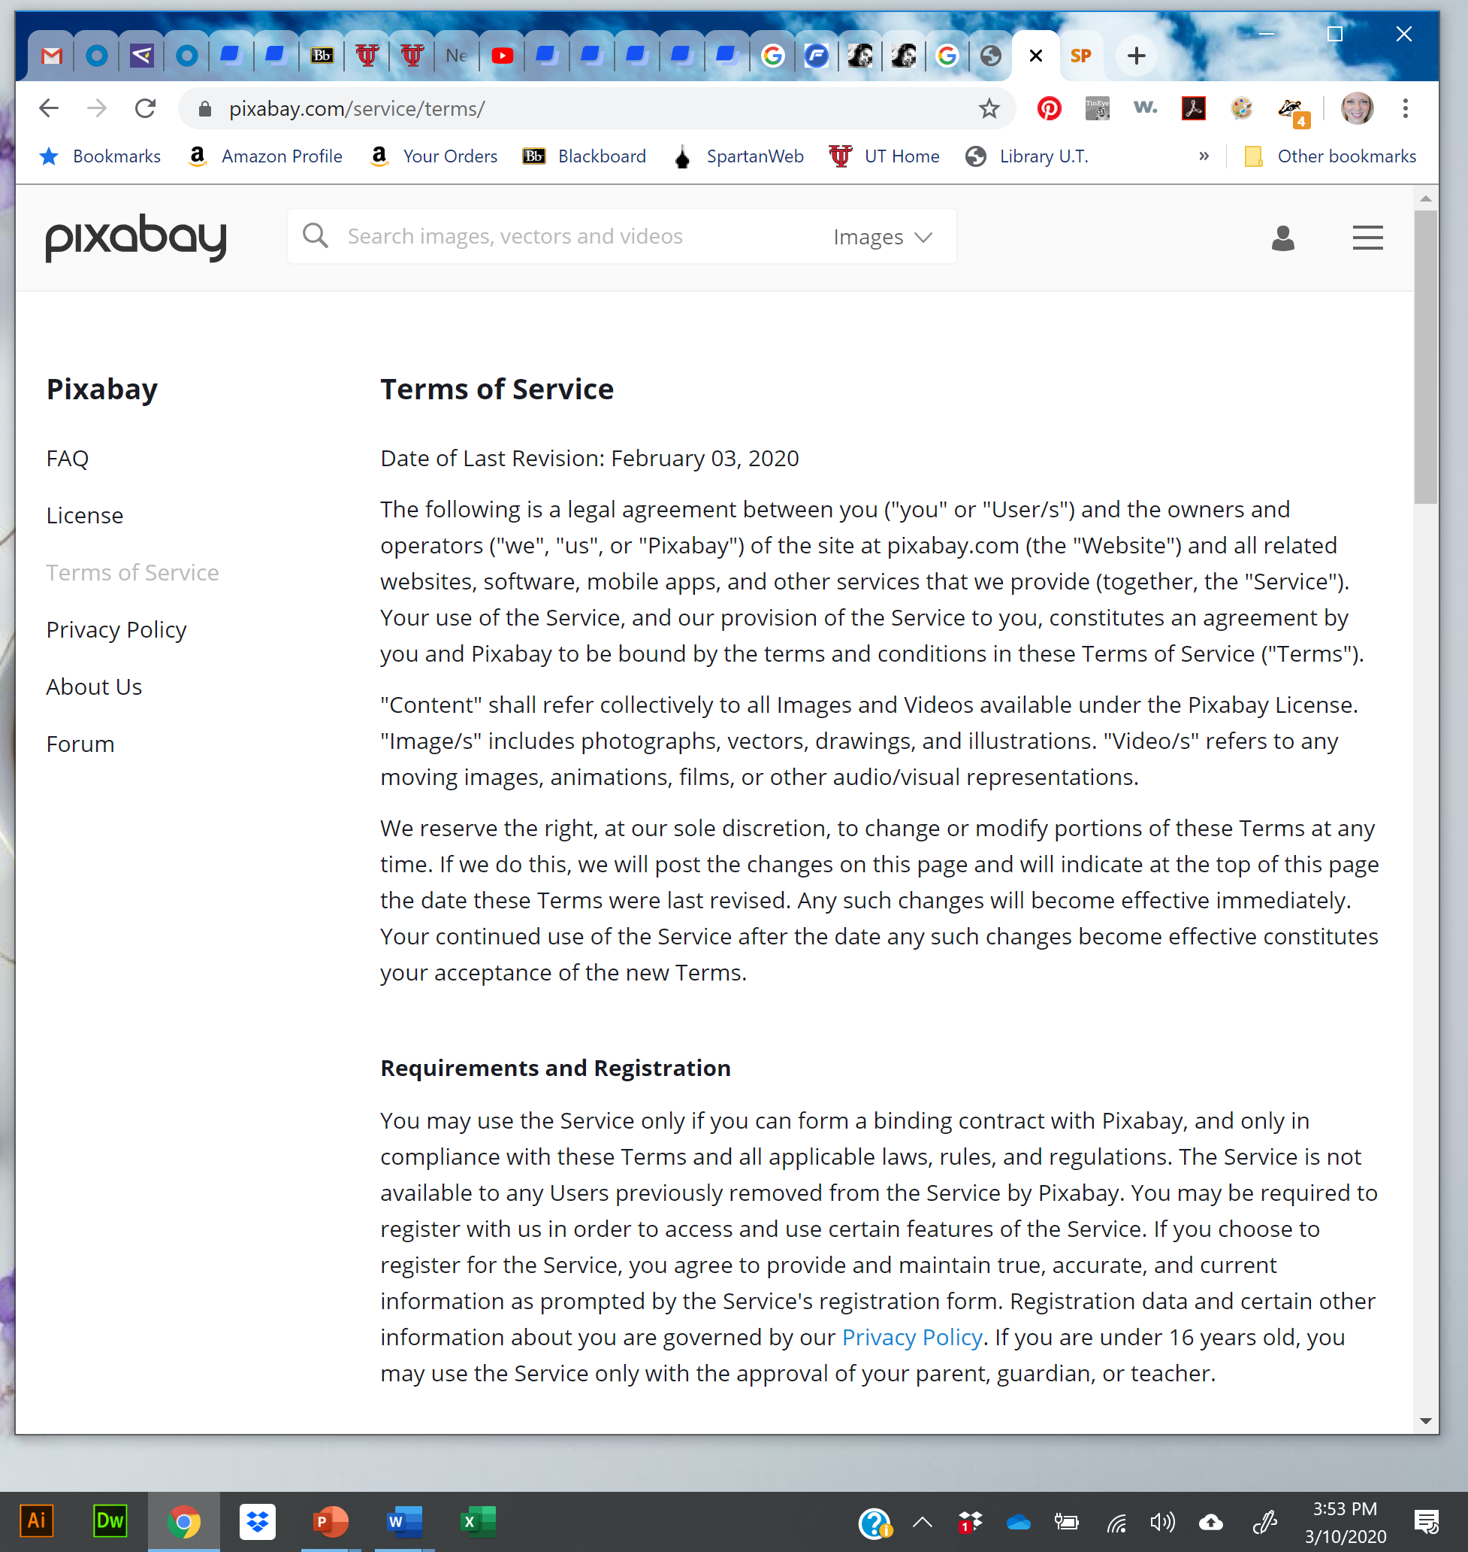
Terms of Service are subject to change.
But you can take screen shots of image pages and terms of service, with your computer time/date stamps, and document the URLs.
https://pixabay.com/service/terms/
Notes:
Terms of service are subject to change, so it’s a good idea to take full screen shots of image pages with your computer time stamp and to document the URL’s.

Slide 28
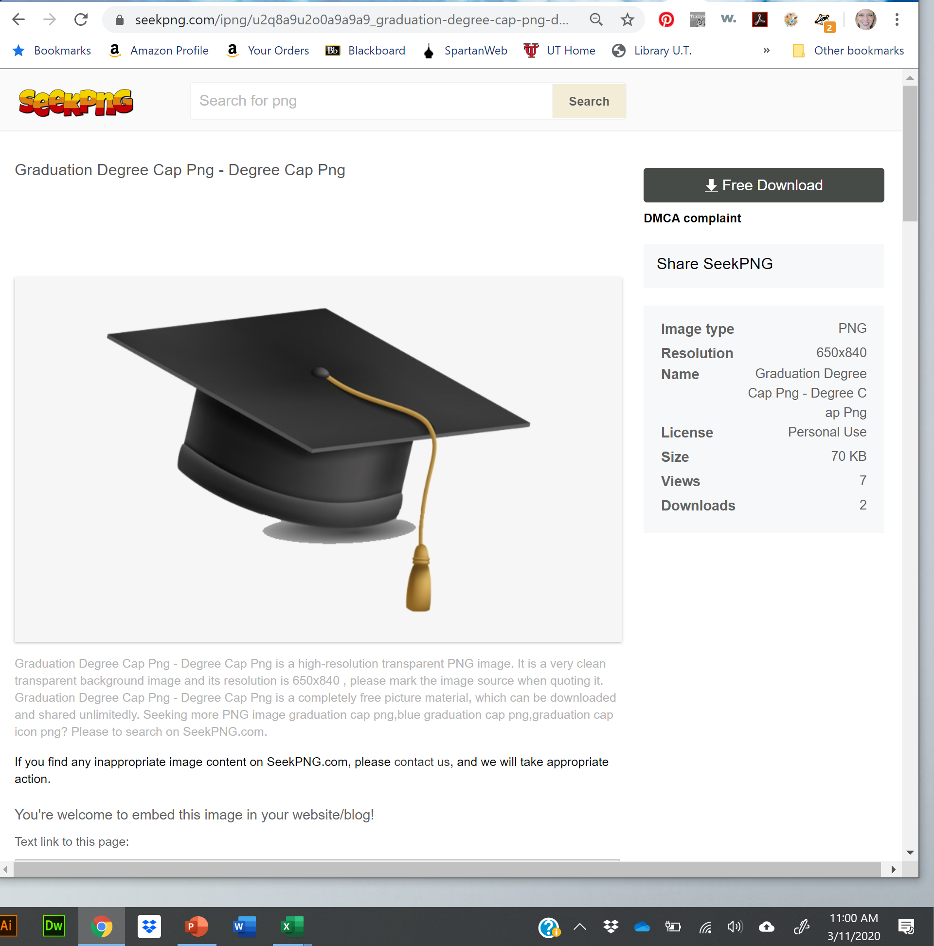
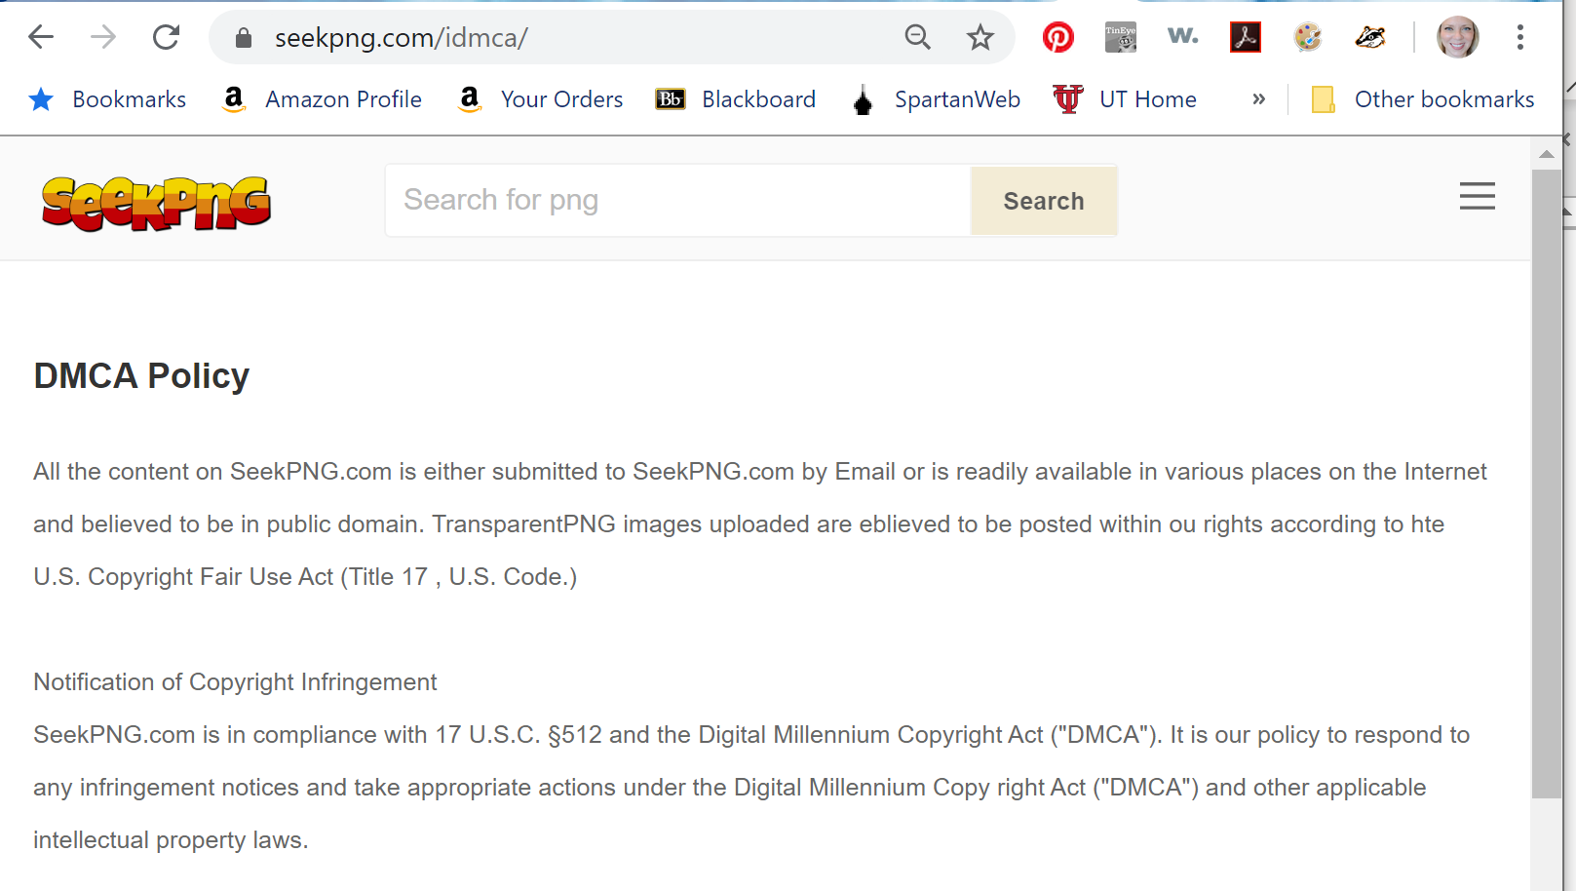
The graduation cap is also a free download.
The website’s terms of service say all images are “believed to be” in compliance with copyright law
But the statement shows a misunderstanding of “Public Domain.”
If you’re doing commercial work for a client, another source might be more reliable.
Notes:
The graduation cap is also a free download, but the website’s terms of service say they believe their images are in compliance with copyright law, but who knows what people are uploading? They also claim all images are in “public domain,” which suggests a misunderstanding of this term. So if you’re doing commercial work for a client, another source might be more reliable.

Slide 29
The Digital Millennium Copyright Act of 1998 (DMCA)
creates limitations on the liability of online service providers for copyright infringement when engaging in certain types of activities.
So it’s a good idea to make sure you have credible sources.
copyright.gov/legislation/dmca.pdf
Notes:
The Digital Millennium Copyright Act of 1998 limits the legal liability of websites like these that allow people to post and download work.
So it’s a good idea to use credible sources.

Slide 30
What about this musical performance of “Pomp and Circumstance?” Which of the FLIP conditions applies?
Hint: While composition is old (from 1904) and the copyright has expired, it’s a new performance recorded by Blue Claw Philharmonic. That recording is protected under copyright.
I purchased a download for 99 cents here on Amazon, but I don’t own the rights to license it or publish it.
17 U.S. Code § 110 This law allow teachers to screen media (full films, etc.) during face-to-face instruction if the school is nonprofit
And “fair use” allows people to referece short excerpts for educational purposes.
Notes:
V.O. [Read slide.] __________________________________________________
NOTES: 17 U.S. Code § 110. “Limitations on exclusive rights: Exemption of certain performances and displays” QUOTE: “(1)performance or display of a work by instructors or pupils in the course of face-to-face teaching activities of a nonprofit educational institution, in a classroom or similar place devoted to instruction, unless, in the case of a motion picture or other audiovisual work, the performance, or the display of individual images, is given by means of a copy that was not lawfully made under this title, and that the person responsible for the performance knew or had reason to believe was not lawfully made;” See Cornell Law School’s Legal Information Institute (which provides open access to U.S. laws) https://www.law.cornell.edu/uscode/text/17/110
______________________________________________________
MEDIA SOURCES: Blue Claw Philharmonic. “Pomp and Circumstance” (Orchestra Extended Longest Mix) From the Album Pomp and Circumstance: Graduation March Processional (Remix 4) Release Date: February 17, 2016
Label: Blue Claw Music Purchase Date: 23 May 2019 (Juliet Davis) Amazon.com https://www.amazon.com/Pomp-Circumstance-Orchestra-Extended-Longest/dp/B01BV36KRG/ref=sr_1_3?crid=229IWDVXCKU0R&keywords=pomp+and+circumstance+mp3&qid=1558645602&s=gateway&sprefix=Pomp+and+Circu%2Caps%2C175&sr=8-3 Bulldog Photo: Pixabay.com (free download): https://pixabay.com/photos/bulldog-bull-dog-happy-english-dog-1275748/ License: CC0 Creative Commons Free for commercial use, no attribution required. “Graduation Degree Cap” Image: Source: www.SeekPNG.com: License: (free download) Personal Use https://www.seekpng.com/ipng/u2q8a9u2o0a9a9a9_graduation-degree-cap-png-degree-cap-png/ https://www.seekpng.com/ks/cap/ ________________

Slide 31
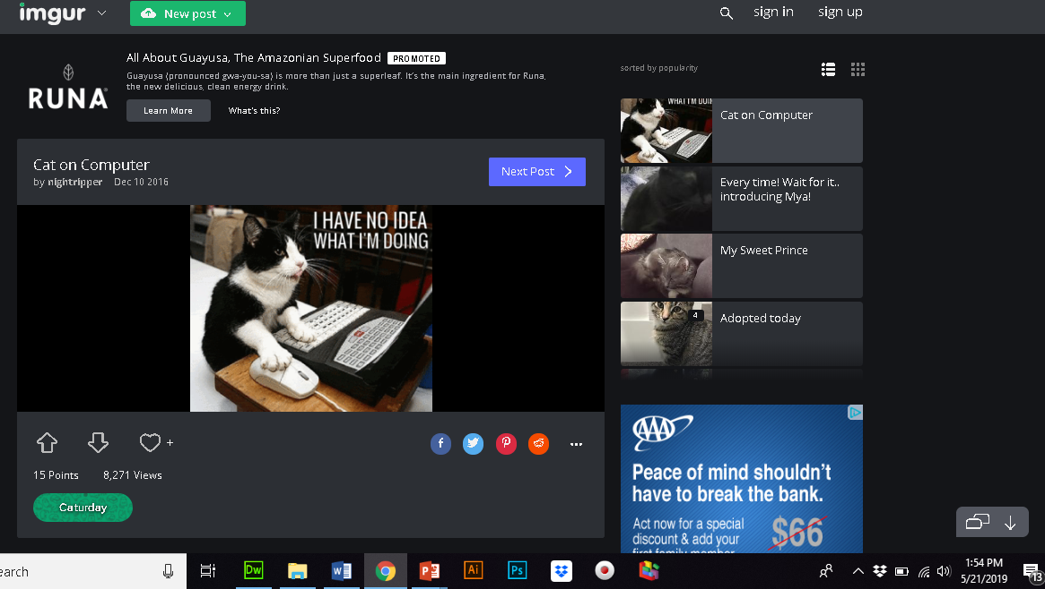
Imgur allows downloads for “fair use” that are noncommercial. What are some ways this image could be used?
Answer: Not-for-profit criticism, comment, news reporting, teaching, scholarship, research.
Notes:
What about this crazy cat gif? The sound effect is a free download, and the gif is from Imgur, which allows fair use of its images. What does that mean?
Pause the video and check your notes. The answer is: [Click] These images can be used for criticism, comment, news reporting, teaching, scholarship, research.

Slide 32
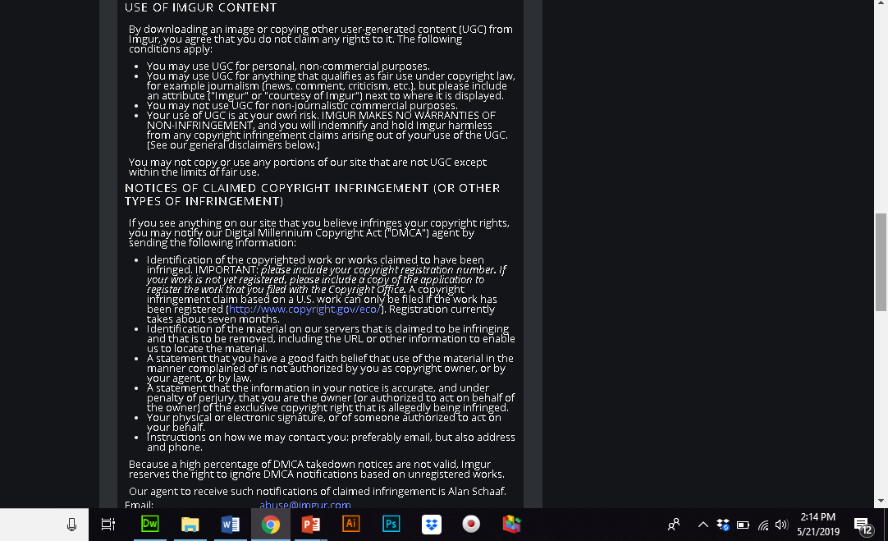
Screen Shots: Terms of Service
Notes:
Imagur’s “Terms of Service” states irts policies here. https://imgur.com/tos

Slide 33
Which FLIP condition is this?
Image: Utah Prisoners, 1885 Author: John P. Soule U.S. Library of Congress WikimediaCommons.com https://commons.wikimedia.org/wiki/File:LOC_Utah_Prisoners_c1885.jpg Accessed 11 Mar 2020
Answer: Public Domain. The image can be used freely because it’s out of copyright.
Notes:
Which FLIP condition is this? Here’s a clue: It’s a photo from 1885, which means the copyright has expired. Any images published prior to 1923 have expired copyright. But copyright laws have changed over the years, and, in another video, we’re going to look at which works have expired after 1923 as well. So, pause the video and check your notes to see which FLIP condition applies. The answer is [click] “Public Domain.” The image can be freely used because it’s out of copyright.
_____________________________________________ MEDIA SOURCES: Image: Utah Prisoners, 1885 Author: John P. Soule United States Library of Congress's Prints and Photographs division under the digital ID cph.3b27385. WikimediaCommons.com https://commons.wikimedia.org/wiki/File:LOC_Utah_Prisoners_c1885.jpg Accessed 11 Mar 2020

Slide 34
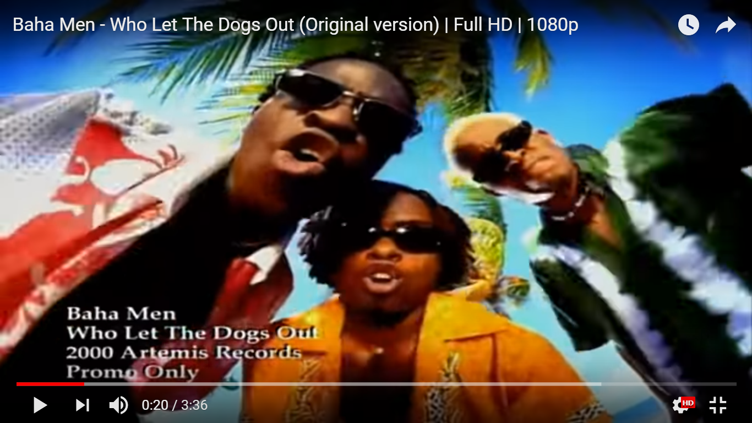
Which FLIP condition was intended here?
HINT: We used a short excerpt of this song for educational purposes, to show a common scenario of infringement.
Answer: Fair Use was intended.
Notes:
Which FLIP condition was intended?
HINT: We used a short excerpt of this song for educational purposes, to show a common way students accidentally infringe—by taking a music track from their favorite song. Answer [click]: Fair use was intended.
_____________ MEDIA SOURCE: Baha Men. “Who Let the Dogs Out.” Records, 2000. Posted to YouTube by Atriem Records: https://www.youtube.com/watch?v=Qkuu0Lwb5EM. Accessed: 20 Jun 2018 Featured under the auspices of fair use for educational purposes, in limited amount, to demonstrate a common student practice.

Slide 35
But this YouTube video with the “Bad Boys” theme was used for entertainment only, so I would likely need to get permission to use these if I were not commenting on them now for educational purposes.
Notes:
But this YouTube video with the “Bad Boys” theme was used for entertainment only, so I would likely need to get permission to use these if I were not commenting on them now for educational purposes. This is actually an excerpt from a YouTube video on Dubai Police Cars, supposedly the fastest in the world.
(The siren sound effect was a free download.)
__________________________ MEDIA SOURCES: Video Source: YouTube, https://www.youtube.com/watch?v=xKHYW8PZQ9Y Excerpt from: “Dubai Police Cars – The World’s Fastest Police Cars!” SFX: Flashkit.com free download.

Slide 36
PAID Licensing
Notes:
For these images, I purchased licensing from VectorStock.com

Slide 37
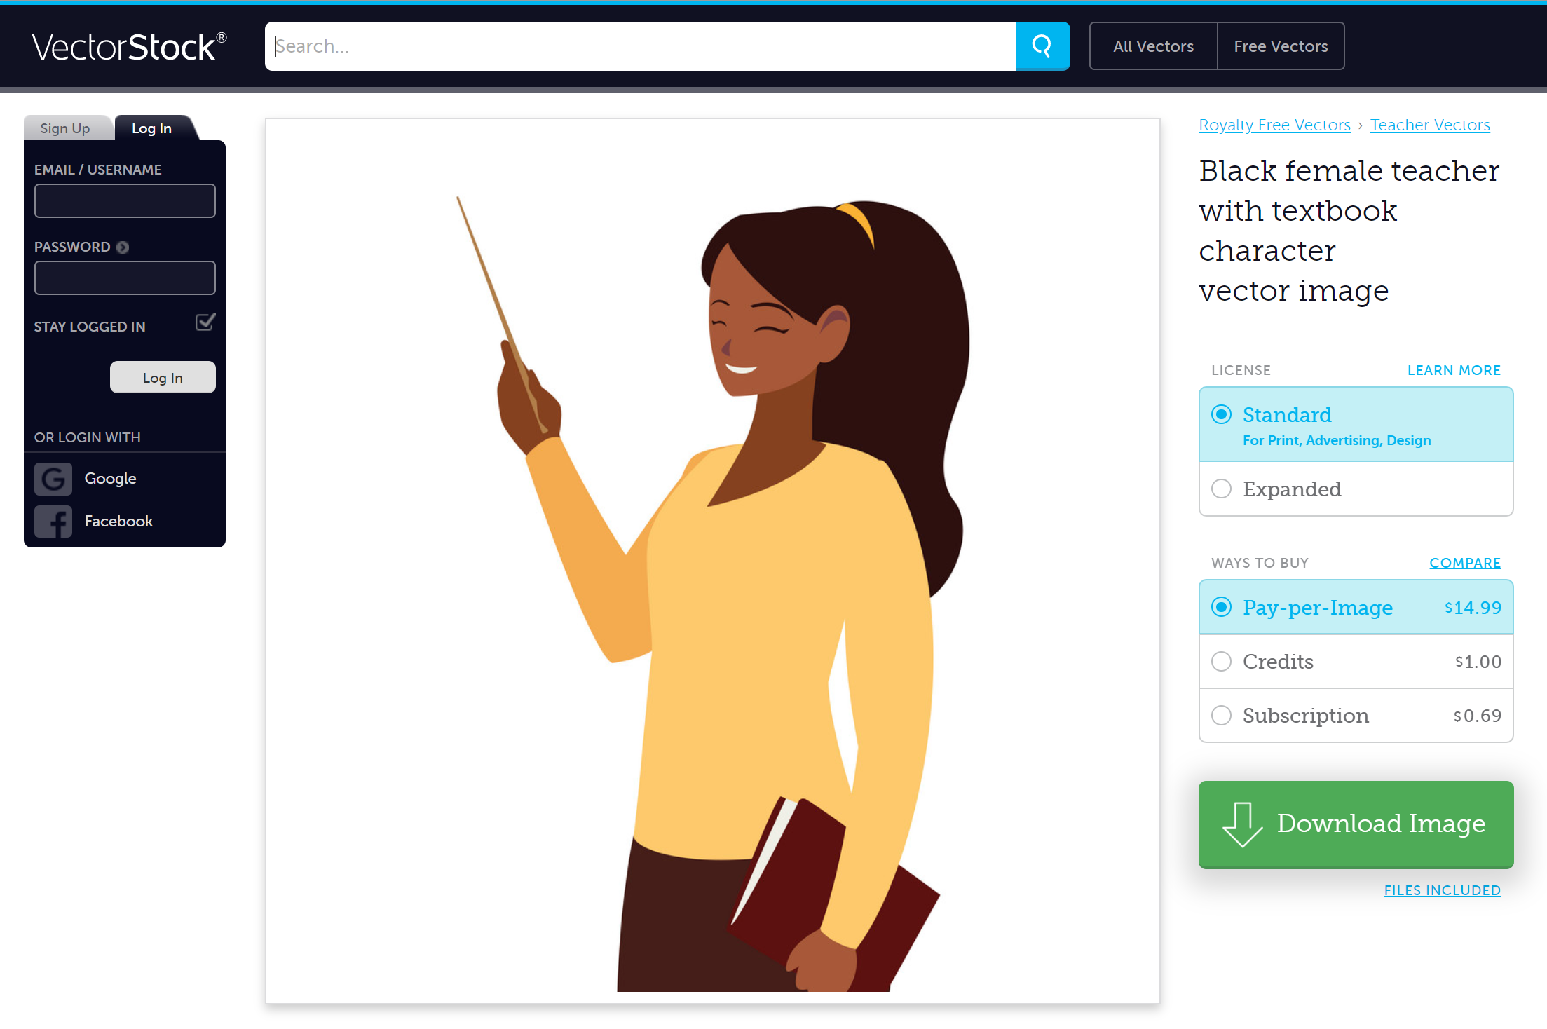
Notes:
Here’s the website where I downloaded this one.

Slide 38
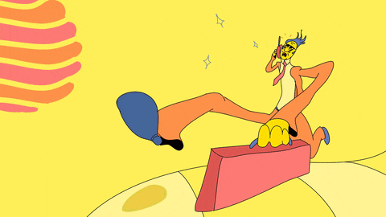
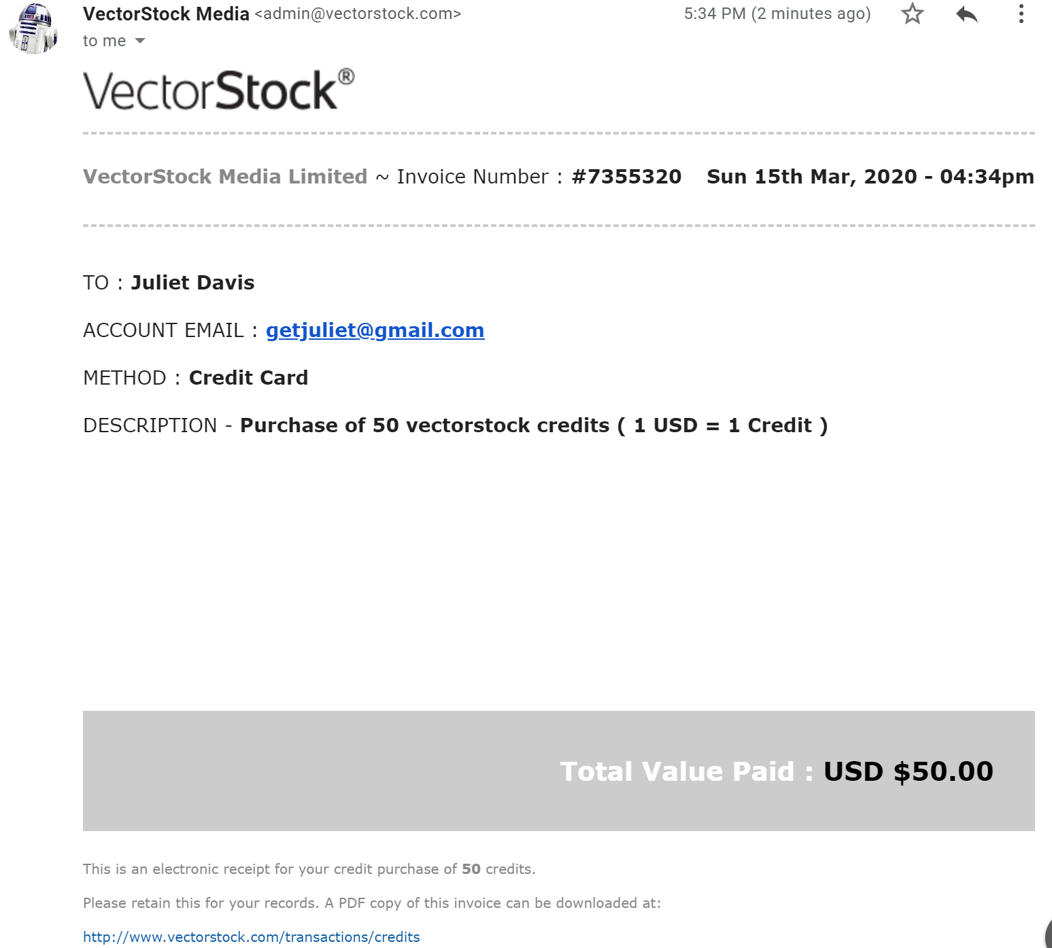
Keep your receipts
Notes:
And here’s the receipt I keep for my records—in my project folder, for easy access.

Slide 39
Review FLIP
Fair Use: limited use for criticism, comment, news reporting, teaching, scholarship, research
Licensing/Permissions: use under specified conditions articulated in writing
I created it: Original Authorship
Public Domain: use of work with expired copyright or from a U.S. government source
Notes:
Our next videos will provide much more information and context about each of these conditions.

Slide 40
EXERCISE: Treasure Hunt
GROUPS Form groups of 3-4 people. Each group will search the Internet to find the assigned media below. Group 1) + A sound effect of your choice + A song from a personal collection or from the Internet Group 2) + A YouTube video of your choice + A personal video someone has created in your group. Group 3) + A photo from the Internet + Clip art from the Internet + A personal photo from someone in your group. Group 4) + A quote from a news story. + An image or video from that news story.
DOCUMENT: Document your finds using the following steps: 1) create a Word doc or PowerPoint, and insert the media you found in the document you created. 2) Identify the author, title (if any), website name, URL, and date you accessed it (e.g., accessed 20 Mar 2064). 3) Describe any licensing info you have found (e.g., free for noncommercial use). 4) take a screen shot of the page where it was found—include your computer’s time/date stamp. 5) take screen shot(s) of the terms of service page(s), if any—include your computer’s time stamp.
IDENTIFY & EXPLAIN (Think “FLIP”) 6) Identify ways you believe you could use this media without infringing on copyright. Explain. 7) Identify ways you believe you would be infringing on copyright by using this media. Explain.
Notes:
Meanwhile, here’s a group treasure hunt exercise your instructor might use to reinforce concepts in the video.

Slide 41
3 Ways Instructors Can Use These Materials
TRADITIONAL USE Teacher presents PPT or videos in class followed by discussion, exercises, and quizzes.
FLIPPED” CLASS Students read the PPT themselves or view the videos. Class time focuses on the discussions and exercises. Quizzes follow.
ONLINE TESTING Students view the PowerPoints or videos and take tests on their own time.
RESOURCES - Discussions & Exercises (end of each section) - Quiz Bank (by request: juliet.davis@ut.edu)
FOR EDUCATIONAL USE. NOT LICENSED FOR COMMERCIAL SCREENING
Notes:
Instructors who are provided access can use this video series for traditional use, flipped classes, or online testing. And class exercises appear at the end of each segment. These materials are for educational use and are not licensed for commercial screening. ___________________________________________ MEDIA SOURCES: Purchased license at VectorStock.com through account: Juliet Davis https://www.vectorstock.com/royalty-free-vector/teacher-male-with-documents-character-vector-25078218

Slide 42
Questions?
Notes:
Let your teacher know if you have any questions about this introduction.

Slide 43
Does this make me look fat?
Notes:
IMAGE SOURCE:
“The 34 Most Hilarious But Awful Pet Haircuts”
BLAZE PRESS UPDATED:MAR 24, 2015 ORIGINAL:MAR 14, 2014 https://blazepress.com/2014/03/34-hilarious-awful-pet-haircuts/

Slide 44
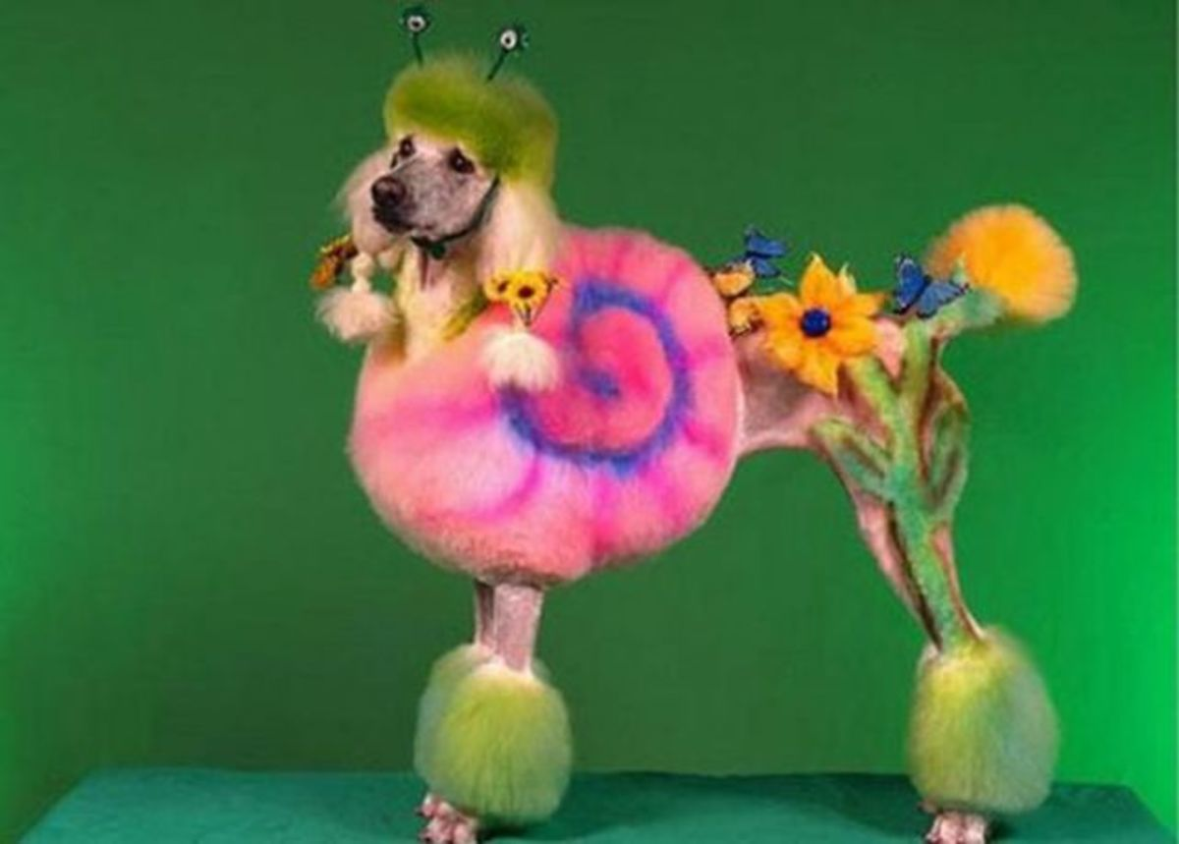
NOOOOOO!
Notes:
If so, you could be guilty of . . . _________________________
MEDIA SOURCES: SOUND: Flashkit.com (free download) Posted 4/13/2006 “Crying Kid” by Connor Purcell, Freeware http://www.flashkit.com/soundfx/People/Crying Accessed: 5/20/2019 IMAGE SOURCE: NOTE: This image and source will be part of a critical thinking exercise at the end of the presentation and is included under the auspices of fair use for educational purposes. Image Credit: DENIS CHARLET/AFP/Getty Images (permission not granted for free downloads) Featured in this article: Cherlynn Low, Huffington Post, “Pets vs. Facebook: Dogs And Cats Better For Relationships Than Social Media, Study Says,” 6/18/2013
https://www.huffingtonpost.com/2013/06/18/pets-facebook-social-life-media_n_3461329.html
TO GO WITH AFP STORY BY ISABELLE TOUSSAINT - A dog stands in front of a computer screen with a Facebook page opened on it, on January 4, 2013 in Lille, Northern France.

Slide 45
Bibliography
All sources will be listed here (they are already listed in individual slide notes). Format here will be CMS:
Author Surname, First Name or Initial. Image Title. Year. Medium. size. Museum or place image is, Location, URL.

